Slide 1






Regulating alcohol packaging and supply to protect health in Sub-Saharan Africa: evidence from policy systems in Malawi and Uganda (RAPSSA)
Funded by:
(Grant number : MR/V015257/1)
DURATION: June 2022- May 2024
University of Stirling Campus

Slide 2
The RAPSSA Research Team
Dr Isabelle Uny , Research Fellow, Institute for Social Marketing and Health (ISMH) Faculty of Health Sciences & Sport, University of Stirling, UK ( Principal Investigator)
Prof. Nazarius Tumwesigye, Makerere University School of Public Health & Director of the Alcohol, Drugs and Addictions Research Centre (ADARC), Uganda country Lead; Research Assistant FT: Cissie Namanda.
Dr Benjamin Kaneka, Lecturer in Population Studies at the University of Malawi, Malawi country Lead; Research Assistant FT: To be Confirmed
Prof. Charles Parry, Director of the Alcohol, Tobacco, and Other Drug Research Unit at the South African MRC, South Africa.
Marsha Orgill, Senior Researcher the Children’s Institute University of Cape Town, South Africa.
Prof. Niamh Fitzgerald, Professor of Alcohol Policy & Director of the Institute for Social Marketing and Health (ISMH), Faculty of Health Sciences & Sport, University of Stirling, UK.
Prof. Linda Bauld, Bruce and John Usher Professor of Public Health, University of Edinburgh, UK.

Slide 3
We have no conflicts of interests to declare

Slide 4
International Project Advisory group for the study
Florence Baingana**, Regional Advisor, Mental Health and Substance Abuse at World Health Organization, WHO African Region
Dr Sophia Komba**, Chairperson of the East Africa Alcohol Policy Alliance (EAAPA) based in Tanzania
Dr Franklin Umenze** Executive Director of the Association of Advocates Against Alcohol Harm in Nigeria (ASAAHN); Board Chair of the West African Alcohol Policy Alliance (WAAPA)
Mrs Aadielah Maker Diedericks**, Regional coordinator of the Southern Africa Alcohol Policy Alliance (SAAPA)
Ms Prisca Mokgadi**, Southern African Alcohol Policy Alliance (SAAPA), based in Botswana
Dr David Kalema**, Director, Hope and Beyond & Immediate past chair of Uganda Alcohol Policy Alliance (UAPA)
Mrs Juliet Namukasa**, Chair of the Uganda Alcohol Policy Alliance (UAPA) and Country Director of International Aid Services (IAS) Uganda.
Mr Paul Mmanjamwada** Head of Programs, Norwegian Church Aid and Danish Church Aid in Malawi and a Member of the SAAPA Board for Malawi.
Mrs Mphatso Baluwa, Malawi Girl Guides Association (MAGGA); (tbc)
Mr Nelson Zakeyu**, National Coordinator of Drug Fight Malawi and Executive Director of MAPA
Dr J.Shiffman**, Bloomberg Distinguished Professor at Johns Hopkins University (USA)
Prof P.Cairney**, Professor of Politics and Public Policy at the University of Stirling (UK)
(** members have declared no conflict of interest)
Notes:
.

Slide 5
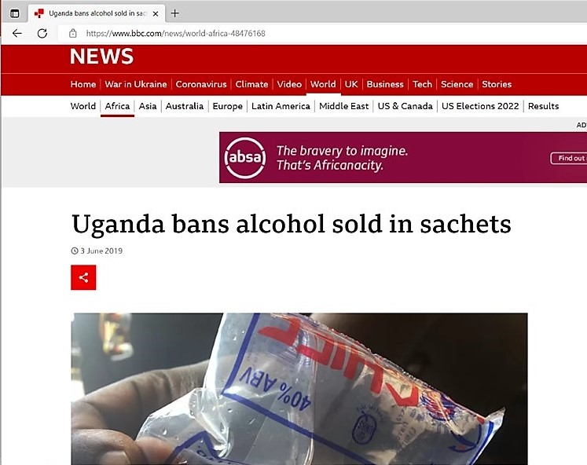
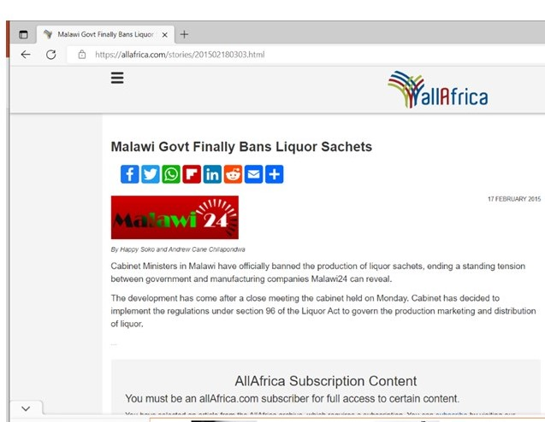
Introduction
Alcohol packaging ( small/ big) has had a impact on consumption levels in different parts of the world leading to higher consumption and harm (Morojele et al. 2021
Muluya et al., 2014).
It was good news when Sachets of alcohol were banned in Malawi in 2015 and Uganda in 2019
Other countries that have banned sachets: Ivory coast (2016), Tanzania (2017), Kenya (2005), Cameroon (2014), Senegal (2019), Nigeria ( planning to 2020)
Paucity of documentation; policy analysis of these bans that can inform other policy changes in other countries

Slide 6
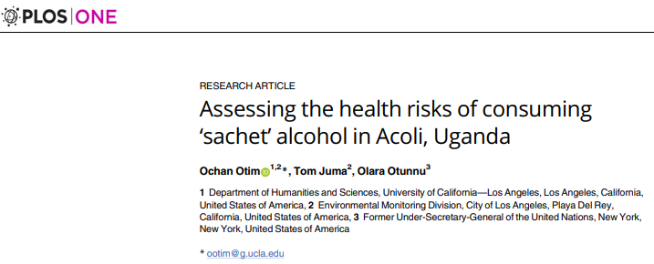
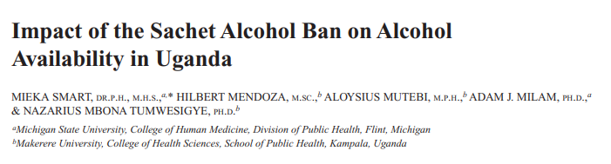
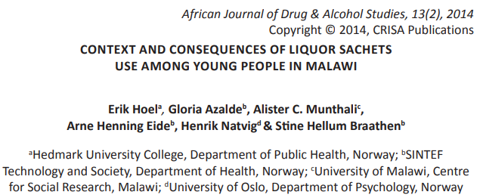
There is still limited literature on the formulation and implementation of sachet (& small packaging of alcohol) bans or policies In Uganda and Malawi

Slide 7
So what do we plan to do?

Slide 8
Study aims
1- To understand the adoption and formulation of the bans, what mechanisms for implementation were proposed and put in place, how the bans were enforced in practice, as well as stakeholder and public perceptions of, and explanations for, intended and unintended consequences of the bans.
2-To explore contextual factors important for the transferability of findings to other Sub-Saharan countries, in order to inform alcohol policy development and implementation across the region.

Slide 9
Study’s work packages: WP1.1 and WP1.2
WP1.1: A Documentary analysis of all main documents related to sachet bans in Malawi and Uganda (consultation documents, policy documents, court rulings, regulations or legislation etc)
We are using all our networks in country to identify key documents.
WP1.2: Key informants interviews (~9 in each country) with key National/district officials), to deepen our understanding of the rationale, context and process of the bans, as well as intended enforcement mechanisms.

Slide 10
Study’s work packages:WP2
In depth interviews with district and local kevel stakeholders ( ~10 in each country) responsible for the enforcement of the bans (e.g. Ministry of Trade and Industry, Bureau of standards, Police etc.) at either district or local level.
To understand experiences of the enforcement and implementation of the ban in each country( inc. respective roles, enforcement effort & experience, barriers and facilitators to enforcement, intended and unintended consequences)

Slide 11
Study’s work package: WP3
Focus group discussion with community members ( ~9 groups in each country; Wakiso ( some in Gulu) in Uganda and Blantyre in Malawi)--At least 3 groups with 16-18 year olds (with parental assent), who have had experience of sachets consumption (including in their networks) prior to the ban. Other groups with health staff from local health centres or hospitals and with traditional/ church leaders/school headteachers local CBOs.
To Understand the problem of consumption of alcohol sachets/ small packaging before and after the ban; lived experiences of the ban(perceived positive and negative impact including on patterns of consumption; any unintended consequences (alternative products consumed; home-produced or illicit alcohol; economic impact); perceived changes in levels of addiction/harm.

Slide 12
Our progress so far

Slide 13
Ethics , RA recruitment, Stakeholders mapping
Contracts in place with all partners ☺
Ethics: obtained at University of Stirling, in progress at UNIMA and MaKSPH.
Research Assistants: recruited in Uganda; shortlisting in Malawi ( took Place Nov22); both Full time.
Stakeholder mapping and WP1.2/ WP2 preparations: country leads & RAs establishing sampling and mapping stakeholders in each country

Slide 14
Project Advisory group first meeting
30.11.22: 1st online meeting with 12 PAG members confirmed!
To hear about their work & own networks
develop the RAPSSA network and gain understanding of similar issues/progress of similar or related policies across the African continent
To support future mechanisms for the dissemination of our findings and their applicability to policy development & policy changes on the continent

Slide 15
Many thanks for listening/ Webale Nnyo/Zikomo Kwambiri!
Please get in touch if you have any questions!
Prof. Nazarius Tumwesigye, Uganda: Makerere University School of Public Health. Email – naz@musph.ac.ug. Twitter: @NazMTumwesigye
Dr Benjamin Kaneka, Malawi: University of Malawi. Email – bkaneka@unima.ac.mw
Dr Isabelle Uny, UK- Email – isabelle.uny@stir.ac.uk
Twitter: @IsaUNY.

Slide 16
References
Morojele, N.K., Dumbili, E.W., Obot, I.S. and Parry, C.D.H. (2021), Alcohol consumption, harms and policy developments in sub-Saharan Africa: The case for stronger national and regional responses. Drug Alcohol Rev., 40: 402-419. https://doi.org/10.1111/dar.13247
Babor TF, Robaina K, Jernigan D. The influence of industry actions onthe availability of alcoholic beverages in the African region. Addiction2015;110:561–71
Munyua, M. M., Nyaga, V. K., & Oundo, M. B. (2014). Selected factors contributing to alcoholism among secondary school students in Mwimbi Division, Kenya. European Scientific Journal, 10(14).
Smart, M., Mendoza, H., Mutebi, A., Milam, A. J., & Tumwesigye, N. M. (2021). Impact of the Sachet Alcohol Ban on Alcohol Availability in Uganda. Journal of studies on alcohol and drugs, 82(4), 511–515.
Hoel E, Azalde G, Munthali A, Eide AH, Natvig H, Braathen SH. Con-text and consequences of liquor sachets use among young people in Malawi. Afr J Drug Alcohol Stud 2014;13:97–106
Otim O, Juma T, Otunnu O. Assessing the health risks of consuming ‘sachet’ alcohol in Acoli, Uganda. PLoS One 2019;14:e0212938
Kifuko R, Kunobwa J, Oriko RO, Okalang U. Effects of Ugandan com-mon sachet alcohol brands on liver catalase activity. J Biol Chem Res2014;31:109–16
Salimu, S., & Nyondo-Mipando, A. L. (2020). "It's business as usual": adolescents perspectives on the ban of alcohol sachets towards reduction in under age alcohol use in Malawi. Substance abuse treatment, prevention, and policy, 15(1), 38.

